Slide 1

EKSPLORASI DATA DAN VISUALISASI MENGGUNAKAN R
Praktikum 4 Data Mining – 1 Maret 2016

Slide 2
Eksplorasi data dan Visualisasi data
1
Visualisasi single variable
Eksplorasi multiple variables
Level plot, countour plot, 3D plot
Menyimpan chart ke dalam file

Slide 3
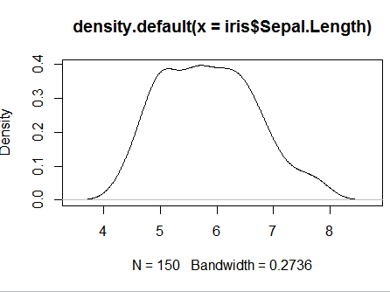
Density
2
data(iris)
plot(density(iris$Sepal.Length))

Slide 4
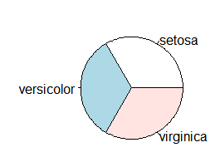
Pie chart
3
freq <- table(iris$Species)
pie(freq)

Slide 5
Eksplorasi data pada multiple variables
4
> cov(iris$Sepal.Length, iris$Petal.Length)
> cov(iris[,1:4])
> cor(iris$Sepal.Length, iris$Petal.Length)
> cor (iris[,1:4])
> aggregate(Sepal.Length ~ Species, summary, data=iris)

Slide 6
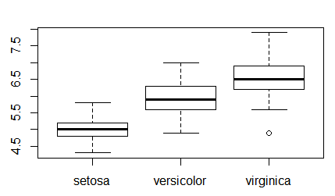
5
Boxplot
.,. The bar in the middle is median.
.,. The box shows the interquartile range (IQR), i.e., range between the 75% and 25% observation.
boxplot(Sepal.Length ~ Species, data = iris)

Slide 7
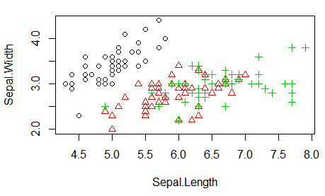
6
Scatter Plot
with(iris, plot(Sepal.Length, Sepal.Width, col = Species, pch = as.numeric(Species)))

Slide 8
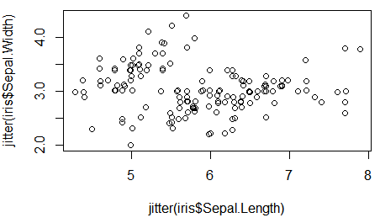
Scatter Plot with Jitter
7
Function jitter(): add a small amount of noise to the data
plot(jitter(iris$Sepal.Length), jitter(iris$Sepal.Width))

Slide 9
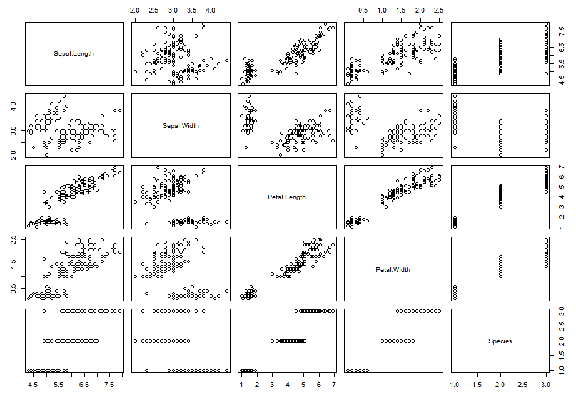
A Matrix of Scatter Plots
8
pairs(iris)

Slide 10
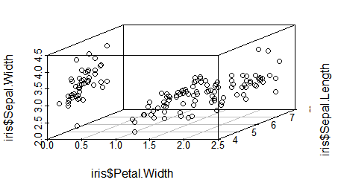
9
3D Scatter plot
library(scatterplot3d)
scatterplot3d(iris$Petal.Width, iris$Sepal.Length, iris$Sepal.Width)

Slide 11
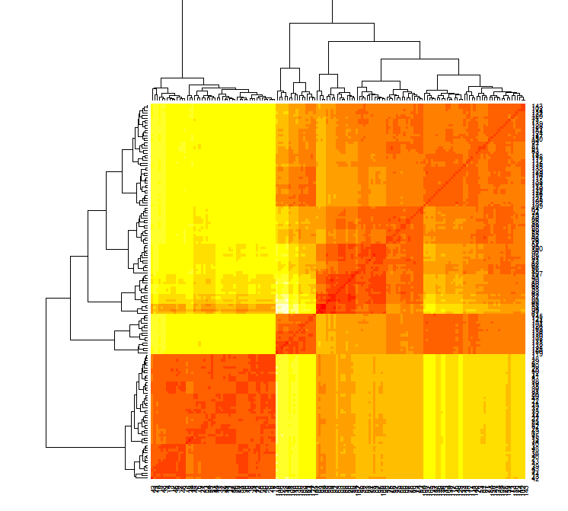
10
Heat Map
Calculate the similarity between different flowers in the iris data with dist() and then plot it with a heat map
dist.matrix <- as.matrix(dist(iris[, 1:4])) heatmap(dist.matrix)

Slide 12
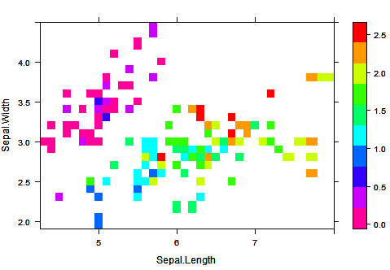
11
Level Plot
Function rainbow() creates a vector of contiguous colors.
library(lattice)
levelplot(Petal.Width ~ Sepal.Length * Sepal.Width, iris, cuts = 9, col.regions = rainbow(10)[10:1])

Slide 13
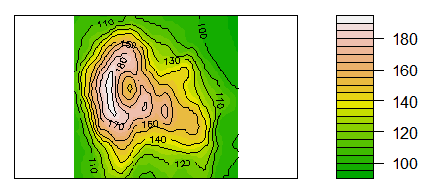
12
Contour
contour() and filled.contour() in package graphics
contourplot() in package lattice
filled.contour(volcano, color=terrain.colors, asp=1, plot.axes=contour(volcano, add=T))

Slide 14
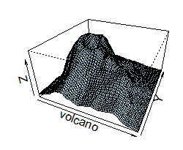
13
3D Surface
persp(volcano, theta = 25, phi = 30, expand = 0.5, col = "lightblue")

Slide 15
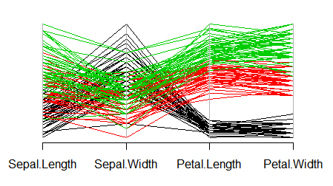
14
Parallel Coordinates
library(MASS)
parcoord(iris[1:4], col = iris$Species)

Slide 16
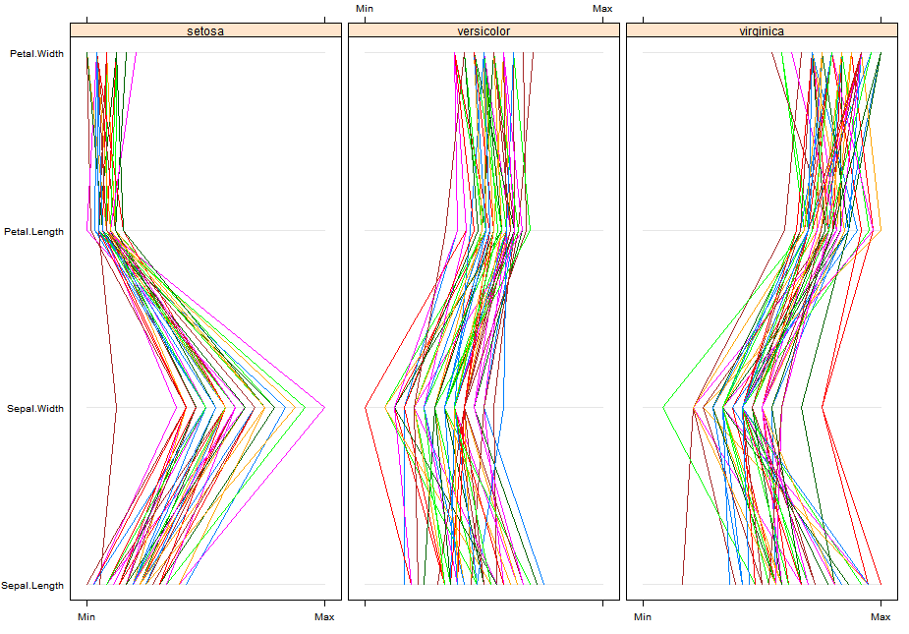
15
Parallel Coordinates with Package lattice
library(lattice)
parallelplot(~iris[1:4] | Species, data = iris)

Slide 17
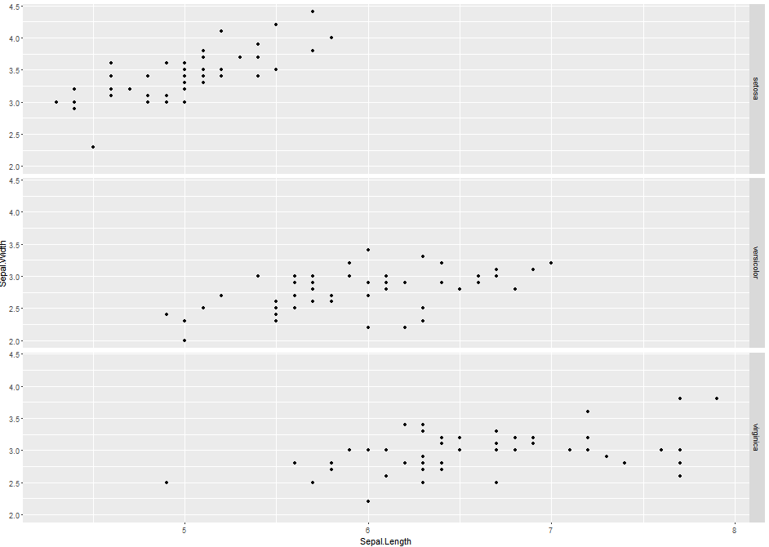
16
Visualization with Package ggplot2
library(ggplot2)
qplot(Sepal.Length, Sepal.Width, data = iris, facets = Species ~ .)

Slide 18
17
Save Charts to Files
Save charts to PDF and PS files: pdf() and postscript()
.BMP, JPEG, PNG and TIFF files: bmp(), jpeg(), png() and
tiff()
Close files (or graphics devices) with graphics.off() or
dev.off() after plotting
# save as a PDF file
pdf("myPlot.pdf") x <- 1:50
plot(x, log(x)) graphics.off()
# Save as a postscript file
postscript("myPlot2.ps") x <- -20:20
plot(x, x^2) graphics.off()
<number> / 39

Slide 19
9
☺ [Tugas LKP Tersedia di LMS] ☺

